Slide 1
Computer Organization
CS1403

Slide 2
This Lecture:
Text Books
Prerequisites
What we are going to study?
Why this course is there in syllabus?
Rather…Why we should study this?
What is Computer Organization and Architecture ?
The course structure.

Slide 3
Text Books
Stalling W., Computer Organization & Architecture, 7th Edition, Pearson Education India, 2010
Hamacher C. etal, Computer Organization, 5th Edition, McGrawHill, 2002
Henneyssy J. L., Patterson D., Computer Organization And Design: The Hardware/Software Interface, Morgan Kaufmann, 2008

Slide 4
Prerequisites
Require Knowledge of
Number System
Decimal, Binary, their inter-conversion etc.
Digital Logic
Boolean Algebra, Karnaugh Maps, Logic Gates, Sequential and Combinational circuits
Data Structure and C/C++ Programming
Probability and Mathematics (10+2 stuff)

Slide 5
Course Objectives
To learn ‐
How computers work, basic principles
How to analyze their performance
How computers are designed and built
Issues affecting modern processors
(caches, pipelines, etc.)

Slide 6
Why to study this course?
Embarrassing if you are a BTech in CS/IT and can’t
make sense of the following terms: DRAM, pipelining, cache hierarchies, I/O, virtual memory
decide which processor to buy: 3 GHz P4 or 2.5 GHz Athlon
Obvious first step for chip designers, compiler/ OS writers

Slide 7
What is Computer?
Input (mouse, keyboard, …)
Output (display, printer, …)
Memory
main (DRAM), cache (SRAM)
secondary (disk,
CD, DVD, …)
Datapath
Control
Input
Output
Processor
(CPU)
Processor
Control
Memory
1001010010110000
0010100101010001
Datapath
1111011101100110
1001010010110000
1001010010110000
1001010010110000

Slide 8
What is Computer Organization?
Is it?
The processor (CPU)…
datapath
Control
Or is it memory, I/O
…implemented using millions of transistors
…impossible to understand by looking at individual transistors
we need...

Slide 9
Abstraction
Should know the abstraction first
Delving into the depths reveals more information
An abstraction omits unneeded detail
helps us cope with complexity

Slide 10
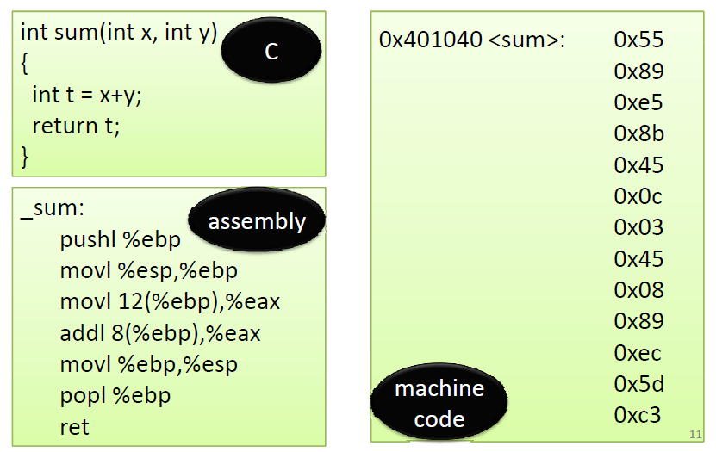
Software Abstraction

Slide 11
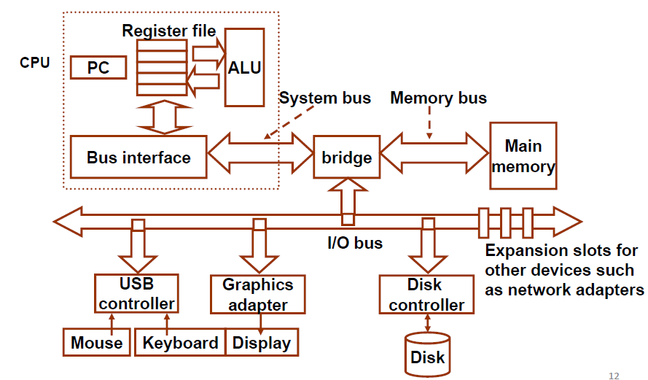
Hardware Abstraction

Slide 12
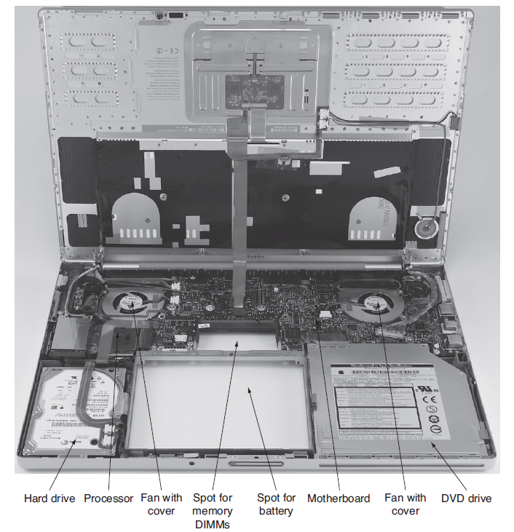
Inside your Laptop

Slide 13
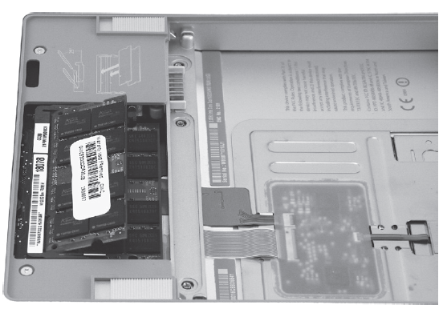
The Memory

Slide 14
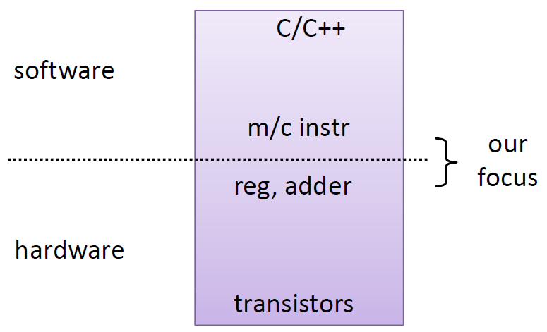
Hardware/Software Interface

Slide 15
Levels of Abstraction
Instruction set architecture (ISA)
Lowest level visible to a programmer
Operation (add/sub/mul/shift)
Micro architecture
Fills the gap between instructions and logic modules
Operation Vs Micro Operation

Slide 16
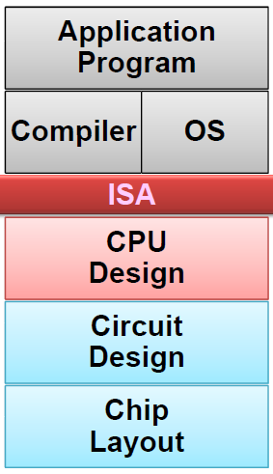
Instruction Set Architecture
Assembly Language View
Processor state (RF, mem)
Instruction set and encoding
Layer of Abstraction
Above: how to program machine
HLL, OS
Below:
what needs to be built
tricks to make it run fast

Slide 17
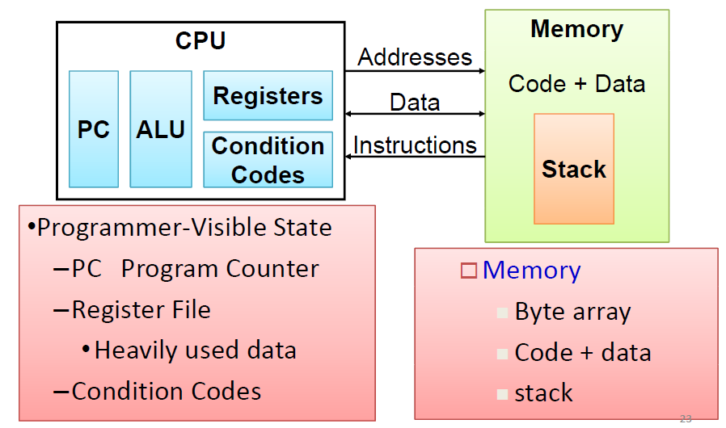
The Abstract Machine

Slide 18
Embedded Computers
Processor as an intelligent electronic component rather than Processor as a computing engine
Real time operation
Requires hardware‐software co‐design
Highly customized

Slide 19
Why Different Processors?
What is the difference between processors used in desk‐tops, lap‐tops, mobile phones, washing machines etc.?
Performance / speed
Power consumption
Cost
General purpose / special purpose
Domain Specific: Network, DSP, Image. Crypto

Slide 20
Topics to be covered:
Performance issues
A specific instruction set architecture
With insight into various addressing modes
Arithmetic and how to build an ALU
Constructing a processor to execute instructions
Data path
Design of Control Unit
Pipelining to improve performance
Memory: caches and virtual memory
Input / output

